Slide 1




SALFORD & CO.
CAR DEALER
Uncovering Used Car Market Insights through Cars24 Web Scraping
Presented by:
Aditya shinde

Slide 2


About Me
ADITYA SHINDE
Bachelor of Engineering in
I am passionate about Data Science, as I enjoy working with data, uncovering insights, and transforming information into meaningful solutions.
I love exploring new technologies, solving real-world problems, and continuously improving my technical skills
My goal is to make data tell impactful stories that drive smart decisions.
Linkedln | GitHub

Slide 3


Why Used Car Data Analysis Matters
HOME
SERVICE
ABOUT US
CONTACT US
The market for pre-owned vehicles is experiencing significant growth, driven by digital platforms. Understanding the underlying data is crucial for competitive advantage.
Market Dynamics
Pricing Variables
Used car markets are booming, powered by platforms like Cars24, OLX, and Spinny, creating massive, complex datasets.
Pricing is highly variable, influenced by factors such as: brand, model, manufacturing year, fuel type, and kilometers driven.
Key Insights Gained
Data analysis helps us quantify: best resale value by brand/model, the impact of fuel type on cost, and critical regional price variations.

Slide 4

CORE OBJECTIVE: ENABLING SMARTER DECISION
buyer’s Dilemma
Seller’s Strategy
"Is this specific car worth the advertised price? How does it compare to market benchmarks?"
"What is the optimal listing price to maximize profit and secure the best resale value?"
We provide data-driven transparency to confirm fair valuation for potential buyers.
We uncover patterns in pricing, mileage, and features to guide optimal selling strategies.
Using Cars24 data, we transform assumptions into data-driven insights.

Slide 5
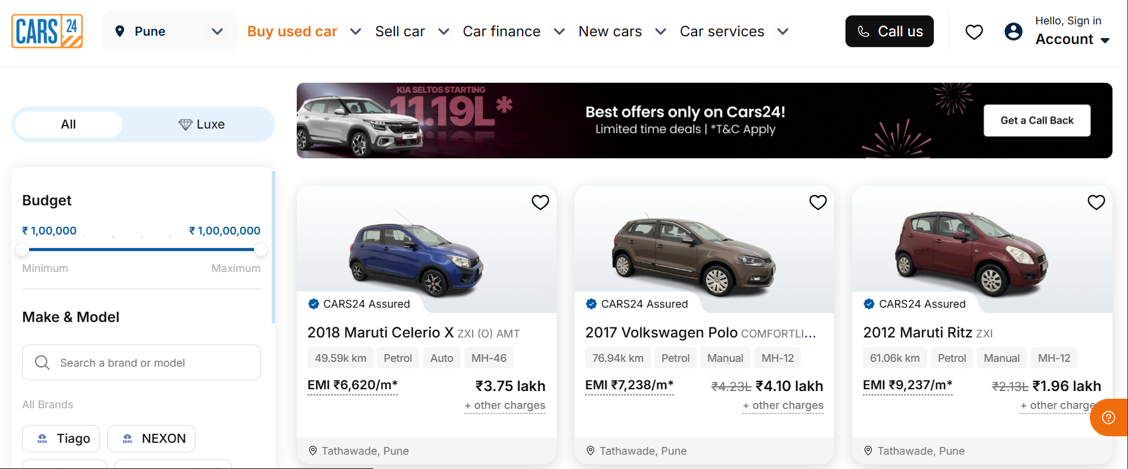
CARS24 WEBSITE INTERFACE

Slide 6
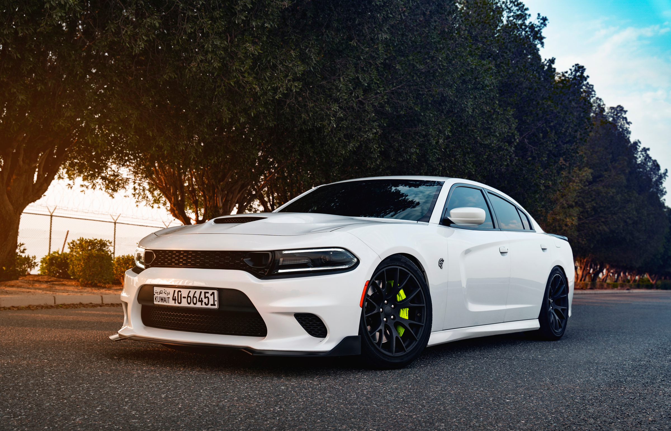
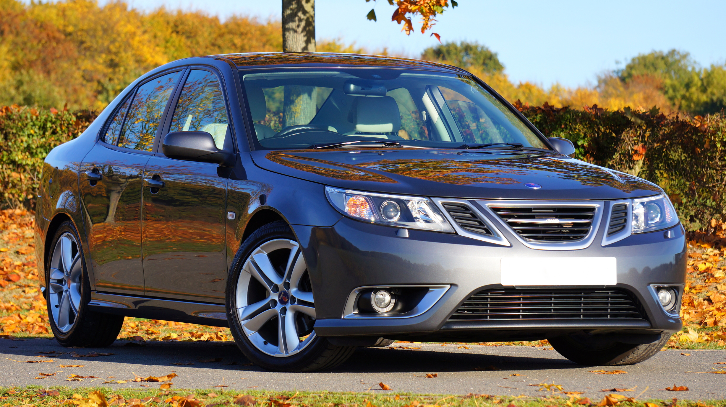
CARS24 PLATFORM
OVERVIEW
Cars24 is a prominent platform in the used automobile ecosystem, facilitating both the buying and selling of pre-owned vehicles across India.
Accessing this data via web scraping allows us to capture real-time market sentiment and pricing.
Data Source: https://www.cars24.com/
4600
2lac
6,981 cr
Employees
Vehicles Sold
Total Revenue

Slide 7

DATA COLLECTION STRATEGY
1. Web Scraping from Cars24
Data was collected by scraping car listings from the Cars24 website using Python libraries such as BeautifulSoup and Requests. Key features like brand, model, fuel type, transmission, price, and year were extracted.
1.
2.
2. Data Cleaning and Preprocessing The raw scraped data was cleaned in the EDA phase — removing duplicates, handling missing values, and standardizing formats for numerical and categorical attributes.
3.
3. Data Structuring for Analysis The cleaned dataset was structured into a Pandas DataFrame with 577 records, ready for exploratory data analysis (EDA) and visualization to uncover patterns and trends.
Total DataSet: 571

Slide 8
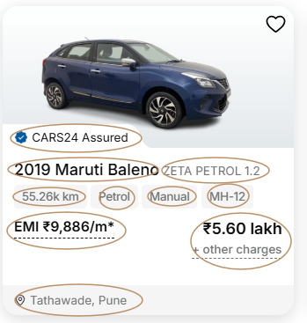
Data Features Extracted
1
Brand
Combined Brand and Model (e.g., Maruti Swift, Hyundai i10)
2
Year
Vehicle Manufacturing Year (key factor for depreciation)
3
Fuel Type
Engine type: Petrol / Diesel / CNG / Electric
4
Transmission
Manual / Automatic gearbox type
5
KM_Driven
Total distance driven
6
Price
Selling Price in Indian Rupees (₹) — the primary dependent
variable

Slide 9
Data Features Extracted
7
EMI_Price
Monthly EMI amount
8
location
The city or state where the car is listed
9

Slide 10
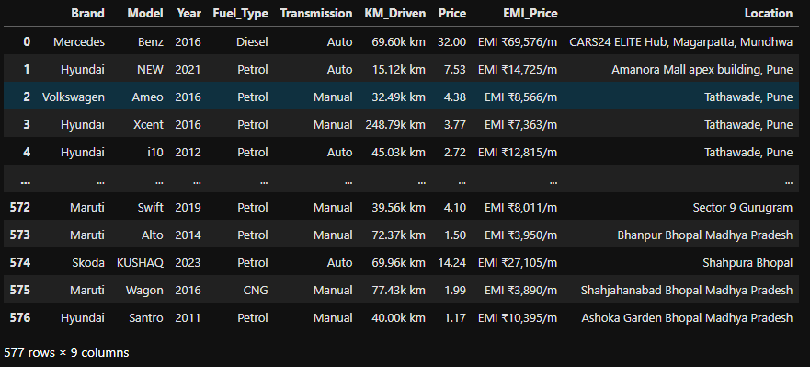
INITIAL SCRAPED DATASET OVERVIEW

Slide 11
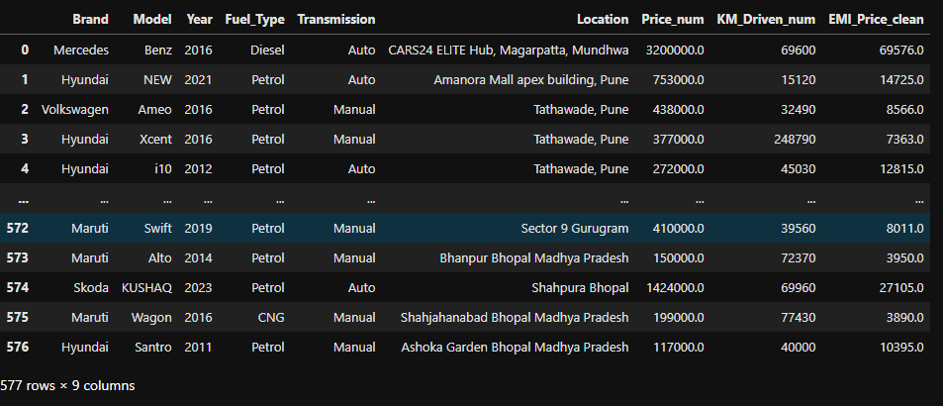
CLEAN DATA READY FOR ANALYSIS

Slide 12





DATA ANALYSIS
Turning Cars data into meaningful insights

Slide 13
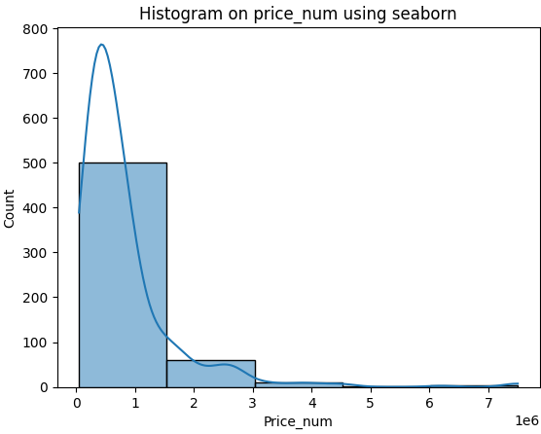
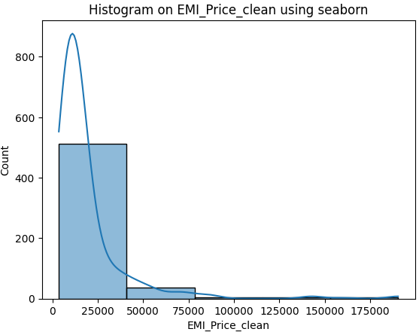
Histogram on Actual Price and Emi price
Insight:
The histogram shows that most car prices are concentrated at the lower end, with a sharp peak below ₹10 lakh
As price increases, the number of cars drastically decreases, indicating fewer high-priced listings
The distribution is right-skewed, meaning most cars are affordable while only a few are luxury or premium models.
The histogram shows that most cars have EMI prices below ₹25,000, indicating affordability for the majority of listings.
A sharp decline is seen as EMI values increase, with very few cars having high EMI amounts.
The right-skewed pattern reflects that premium or luxury cars with higher EMIs are much less common in the dataset.

Slide 14
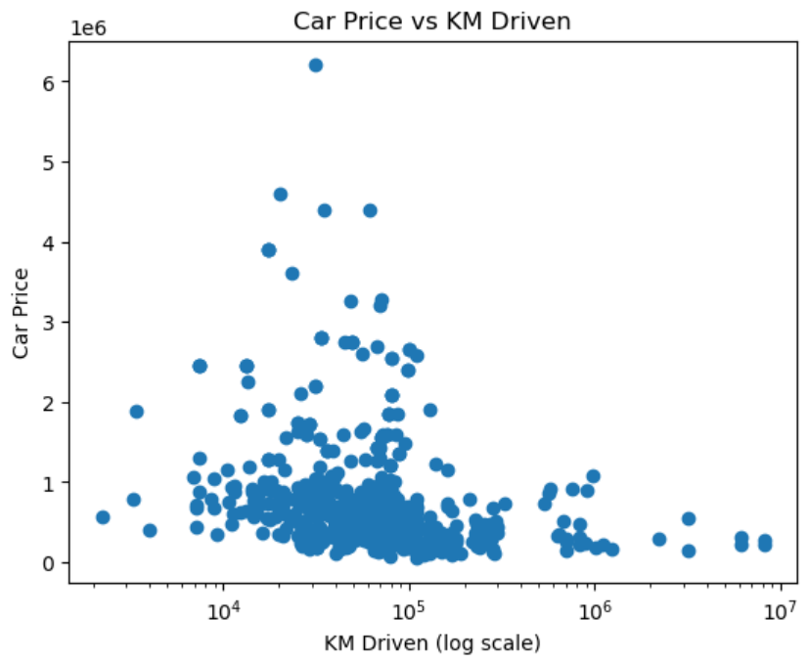

SCATTERPLOT : Car Price VS KM Driven
Insight:
The scatter plot shows that car price generally decreases as the kilometers driven increase, indicating depreciation with higher usage.
Most cars are concentrated between 10,000 km and 20,000 km, suggesting the dataset mainly contains moderately used vehicles.
A few outliers exist with very high prices despite large mileage, possibly representing luxury or premium models.
The log scale on the x-axis effectively spreads the data, revealing that low-driven cars tend to have higher prices overall

Slide 15
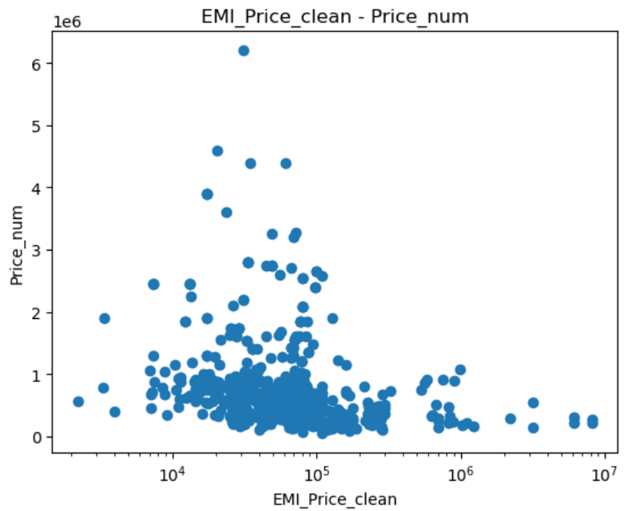
SCATTERPLOT : EMI Price VS Car Price
Insight:
1.The scatter plot indicates a positive relationship between EMI price and car price — as the EMI amount increases, the car price also tends to increase.
2.Most data points are concentrated at lower EMI values, suggesting that the majority of cars have affordable EMI ranges and moderate prices.
3.A few outliers with very high EMI and price values likely represent premium or luxury cars.

Slide 16
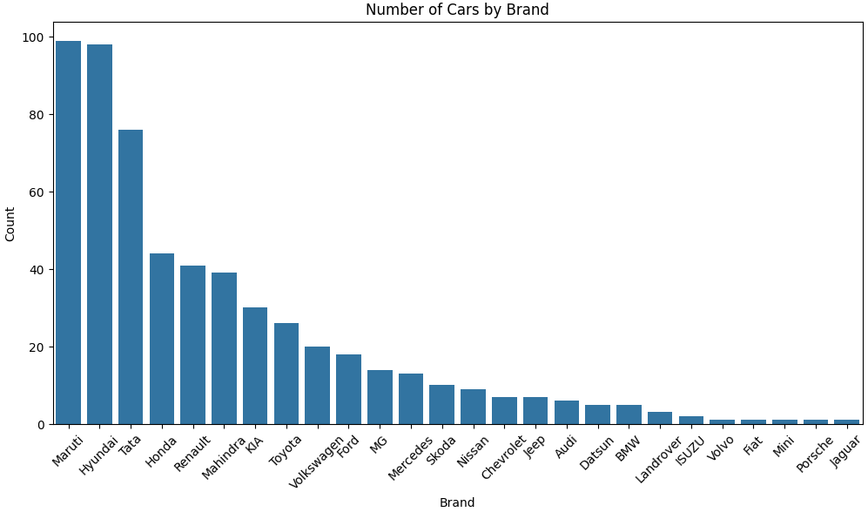

Numerical vs Categorical Visualization
1.Number of Cars by Brand
Maruti, Hyundai, and Tata dominate the used car market with the highest number of listings.
Luxury brands like BMW, Jaguar, and Porsche have minimal representation, showing limited availability or niche demand.
This trend highlights that budget-friendly and reliable brands are more popular among second-hand buyers.
The market is largely concentrated around domestic and affordable brands, reflecting consumer preference for cost-effective options.
Insight

Slide 17
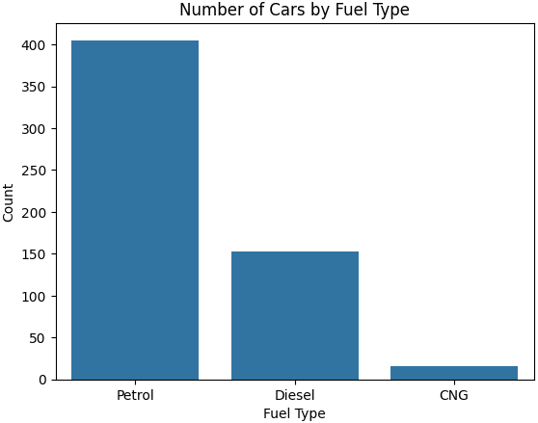
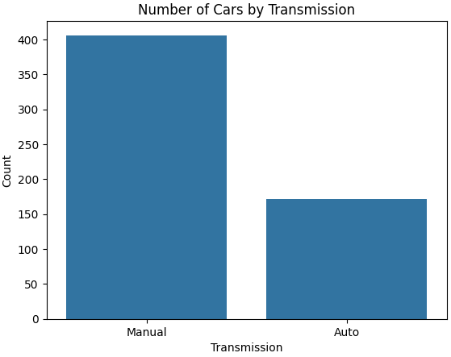
Numerical vs Categorical Visualization
1. Number of Cars by Transmission
Manual cars are far more common than automatic ones, indicating higher demand for manual vehicles in the market.
The smaller share of automatic cars may reflect cost sensitivity and traditional driving preferences.
This trend shows that manual transmissions are still preferred for better mileage and lower maintenance costs.
2.Number of Cars by Fuel Type
Petrol cars make up the majority, followed by diesel, while CNG cars are least common.
This suggests petrol vehicles dominate the dataset, possibly due to their availability and lower maintenance cost.
The data indicates a gradual shift towards petrol vehicles, aligning with changing emission norms and fuel policies.
Insight

Slide 18

REAL-WORLD APPLICATION
SELLER TOOL
BUSINESS INSIGHT
INVESTMENT DECISION
Identify market-competitive price ranges
Help dealers understand
demand trends
Predict which car models retain value longer.

Slide 19



HOME
SERVICE
ABOUT US
CONTACT US
Overall Conclusion
The used car market follows predictable patterns
Web scraping Cars24 data reveals that the used car market follows clear, data-driven trends — empowering smarter, fairer, and more transparent car buying and selling decisions through real-time insights.
Data can help reduce pricing confusion and ensure fairness
Web scraping enables real-time data collection from multiple sources

Slide 20

THANK YOU

